Slide 1
Agentic RAG Chatbot with MCP Integration Multi-Agent Document Processing System Powered by Model Context Protocol & Google Gemini
Key Features:
🎯 4 Specialized Agents with MCP Communication
📄 Multi-format Document Processing (PDF, PPTX, CSV, DOCX, TXT, MD)
🧠 Advanced RAG with Vector Embeddings
💬 Real-time Chat Interface with Source Attribution

Slide 2
Agent-Based Architecture with MCP Integration
🎯 CoordinatorAgent
Orchestrates workflow, manages trace IDs, handles error coordination
📄 IngestionAgent
Multi-format document processing, text chunking, preprocessing
🔍 RetrievalAgent
FAISS vector embeddings, similarity search, context retrieval
🤖 LLMResponseAgent
Gemini-powered response generation, conversation management

Slide 3
Model Context Protocol (MCP)
MCPMessage Structure: {
"type“ : "INGEST_DOCUMENT",
"sender“ : "CoordinatorAgent",
"receiver“ : "IngestionAgent",
"timestamp“ : "2025-07-08T14:56:48.669927",
"trace_id“ : "1450357c-6e81-4ebc-baf9-049f9650f6c3",
"payload":
{
"file_path“ : "C:\\Users\\JEEVAN~1\\AppData\\Local\\Temp\\tmpm31krly0.pdf",
"file_name“ : "K Jeevan Kishore_CV.pdf“
}
}

Slide 4
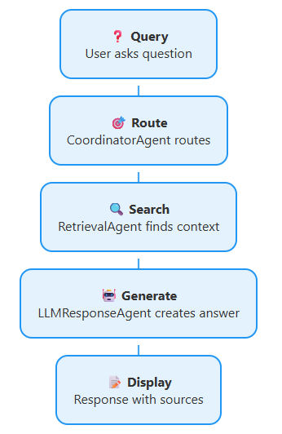
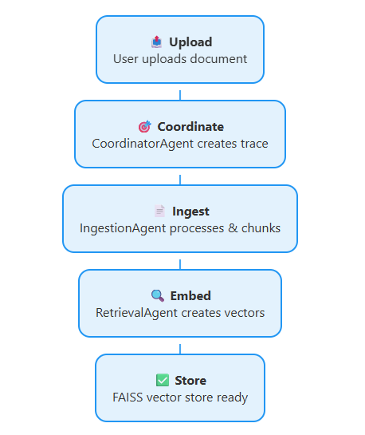
System Flow Diagram
Query Processing Flow
Document Processing Flow

Slide 5
Technology Stack
Frontend - Streamlit
LLM - Google Gemini 2.5 pro
Framework - Langchain
Vector DB - FAISS
Document Processing - PyPDF2, python-pptx, pandas
Async Processing - asyncio

Slide 6
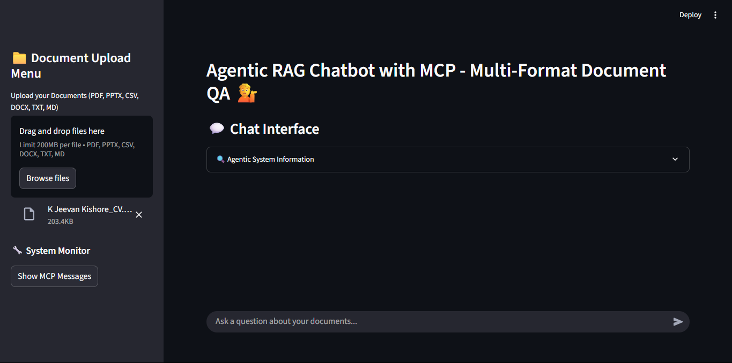
User Interface Screenshots

Slide 7
Challenges Faced
Async Agent Communication Managing asynchronous message passing between agents while maintaining UI responsiveness
Multi-format Processing Handling different document formats with consistent chunking and quality
State Management Maintaining agent states and trace IDs across async operations
Error Handling Implementing robust error propagation through the agent chain

Slide 8
Future Scope & Improvements
Enhanced MCP: Implement persistent message queues and retry mechanisms
Smart Chunking: Semantic chunking based on document structure
Advanced RAG: Hybrid search with keyword + semantic retrieval
Analytics: Usage metrics and performance monitoring dashboard
Multi-modal: Support for images, audio, and video processing
Caching: Intelligent caching for frequently accessed documents

